Slide 1
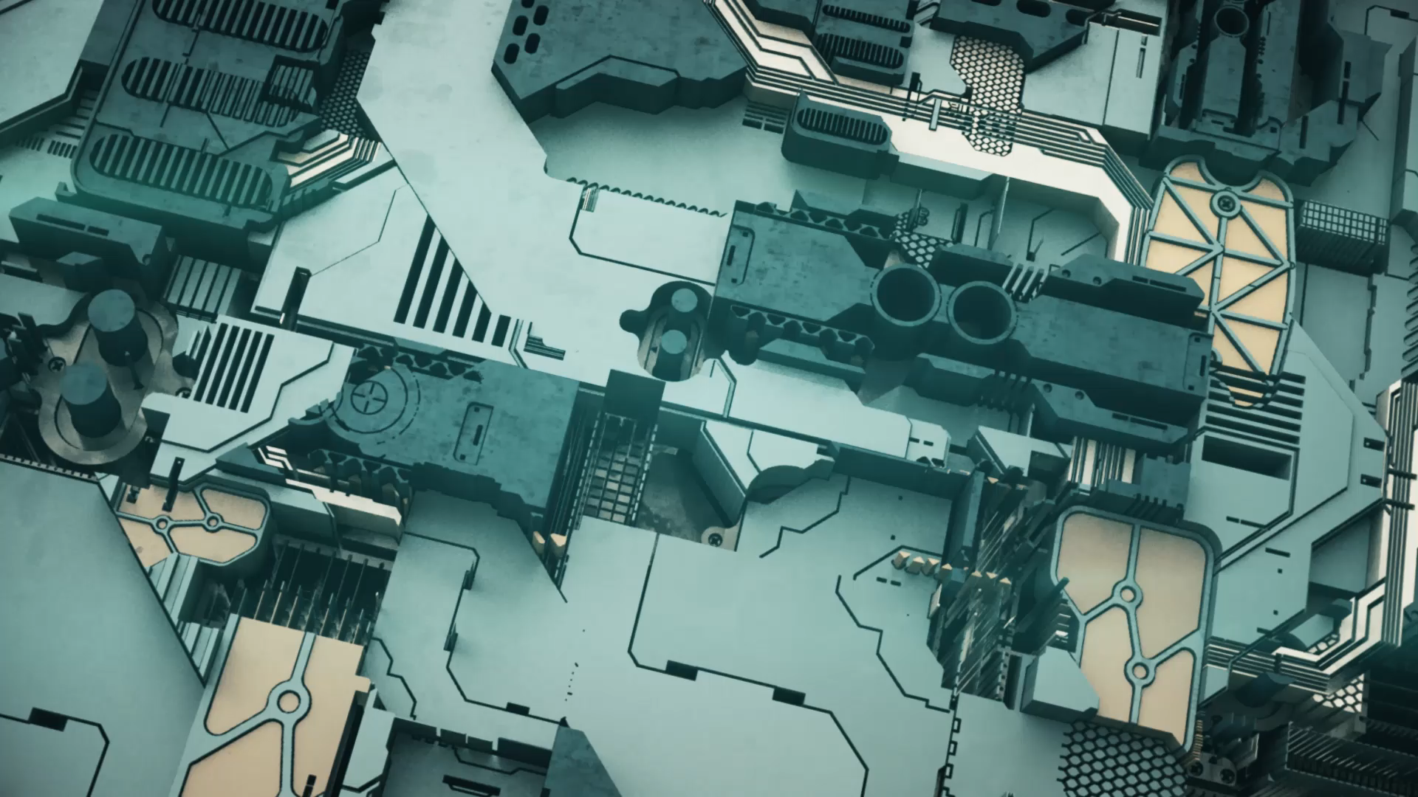
Microprocessor and Computer Architecture
MODULE-I
Presented by
Dr. Ishan Budhiraja
Dr. Manish Raj
Dr. Ankush Jain

Slide 2
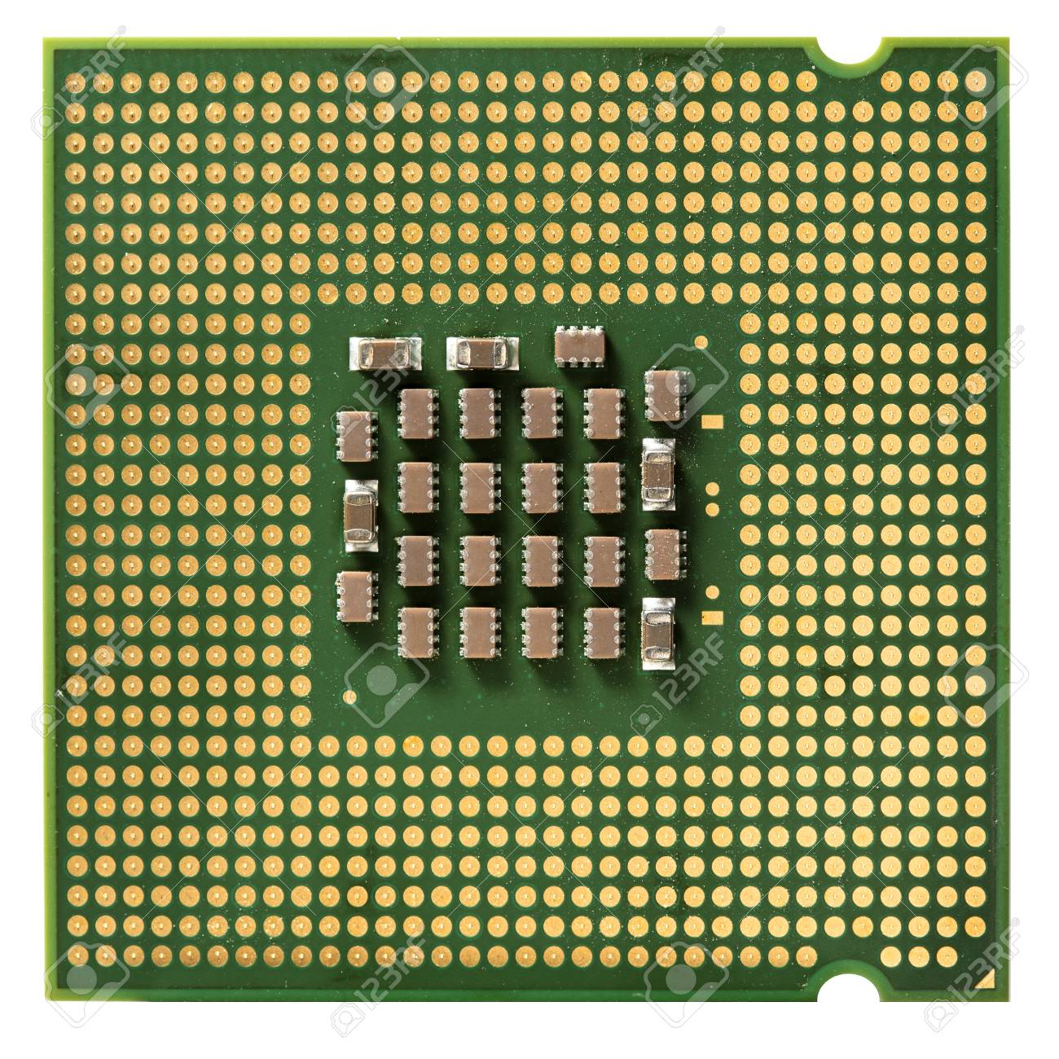
Introduction of Microprocessor
A Microprocessor is an important part of a computer architecture without which you will not be able to perform anything on your computer.
It is a programmable device that takes in input performs some arithmetic and logical operations over it and produces the desired output.
In simple words, a Microprocessor is a digital device on a chip that can fetch instructions from memory, decode and execute them to give results.

Slide 3
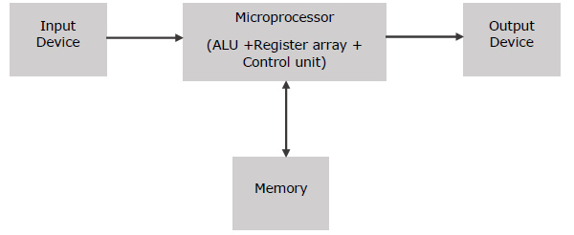
Introduction to Microprocessor (Contd..)
Microprocessor consists of an ALU, register array, and a control unit. ALU performs arithmetical and logical operations on the data received from the memory or an input device.
Register array consists of registers identified by letters like B, C, D, E, H, L and accumulator.
The control unit controls the flow of data and instructions within the computer.

Slide 4
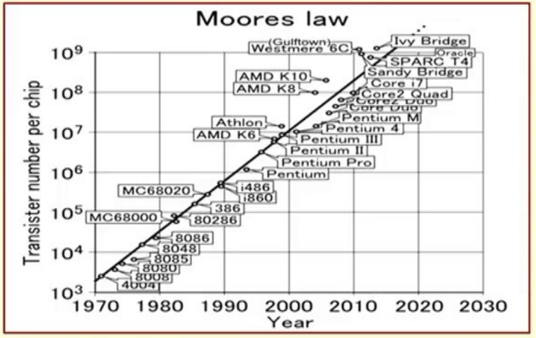
Evolution of Microrprocessors

Slide 5
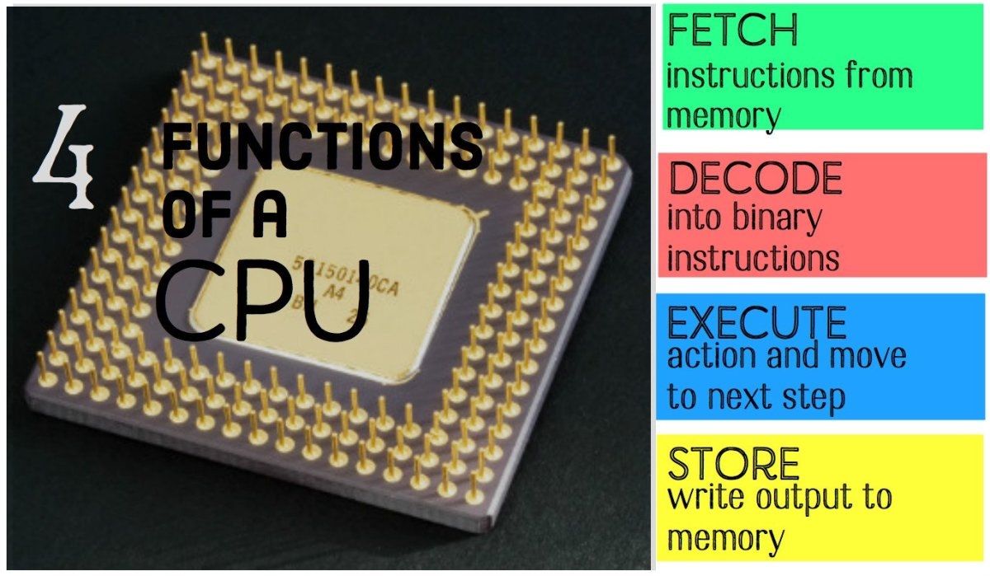
Functions of Microprocessor
The microprocessor follows a sequence: Fetch, Decode, and then Execute.
Fetch
Fetch: Each instruction is stored in memory and has its own address. The processor takes this address number from the program counter, which is responsible for tracking which instructions the CPU should execute next.
Decode
Decode: All programs to be executed are translated into Assembly instructions. Assembly code must be decoded into binary instructions, which are understandable to your CPU. This step is called decoding.
Execute
Execute: While executing instructions, the CPU can do one of three things: Do calculations with its ALU, move data from one memory location to another, or jump to a different address.
Store
Store: The CPU must give feedback after executing an instruction, and the output data is written to the memory.

Slide 6
Terms Used in Microprocessor
Here is a list of some of the frequently used terms in a microprocessor −
Instruction Set − It is the set of instructions that the microprocessor can understand.
Bandwidth − It is the number of bits processed in a single instruction.
Clock Speed − It determines the number of operations per second the processor can perform. It is expressed in megahertz (MHz) or gigahertz (GHz).It is also known as Clock Rate.
Word Length − It depends upon the width of internal data bus, registers, ALU, etc. An 8-bit microprocessor can process 8-bit data at a time. The word length ranges from 4 bits to 64 bits depending upon the type of the microcomputer.
Data Types − The microprocessor has multiple data type formats like binary, BCD, ASCII, signed and unsigned numbers.

Slide 7
Features of Microprocessor
Cost-effective − The microprocessor chips are available at low prices and results its low cost.
Size − The microprocessor is of small size chip, hence is portable.
Low Power Consumption − Microprocessors are manufactured by using metal-oxide semiconductor technology, which has low power consumption.
Versatility − The microprocessors are versatile as we can use the same chip in a number of applications by configuring the software program.
Reliability − The failure rate of an IC in microprocessors is very low, hence it is reliable.

Slide 8
Types of Microprocessor
Complex Instruction Set Computers (CISC)
Reduced Instruction Set Computers (RISC)
Explicitly Parallel Instruction Computing (EPIC)

Slide 9
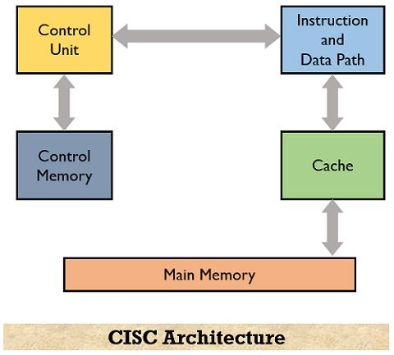
CISC
The CISC approach attempts to minimize the number of instructions per program but at the cost of an increase in the number of cycles per instruction.
Complex instruction, hence complex instruction decoding.
Instructions are larger than one-word size.
Instruction may take more than a single clock cycle to get executed.
Less number of general-purpose registers as operations get performed in memory itself.
Complex Addressing Modes.
More Data types.

Slide 10
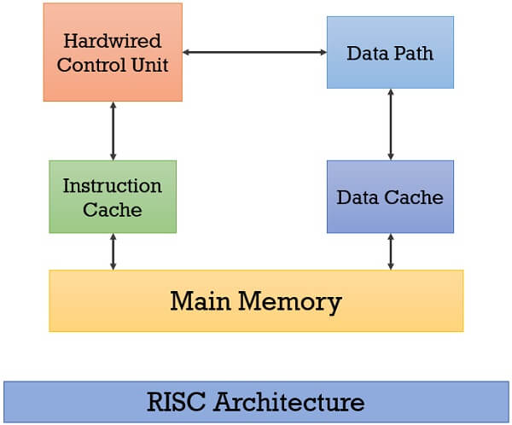
RISC
Reduce the cycles per instruction at the cost of the number of instructions per program.
Simpler instruction, hence simple instruction decoding.
Instruction comes undersize of one word.
Instruction takes a single clock cycle to get executed.
More general-purpose registers.
Simple Addressing Modes.
Fewer Data types.
A pipeline can be achieved.

Slide 11
Types of Microprocessor
Complex Instruction Set Computer (CISC) CISC or Complex Instruction Set Computer is a computer architecture where instructions are such that a single instruction can execute multiple low-level operations like loading from memory, storing into memory, or an arithmetic operation. For example: Intel 386, Intel 486, Pentium, Pentium Pro, Pentium II, Pentium III, Motorola 68000 etc.
Reduced Instruction Set Computer (RISC) – RISC or Reduced Instruction Set Computer is a computer architecture where instruction is simple and designed to get executed quickly. Instructions get completed in one clock cycle this is because of the optimization of instructions and pipelining . RISC makes use of multiple registers to avoid large interactions with memory. For example: IBM RS6000, MC8810, DEC Alpha21064, 21164, 21264.
Explicitly Parallel Instruction Computing (EPIC) – EPIC or Explicitly Parallel Instruction Computing permits computers to execute instructions parallel using compilers. It allows complex instructions execution without using higher clock frequencies. For example: IA-64 Architecture

Slide 12
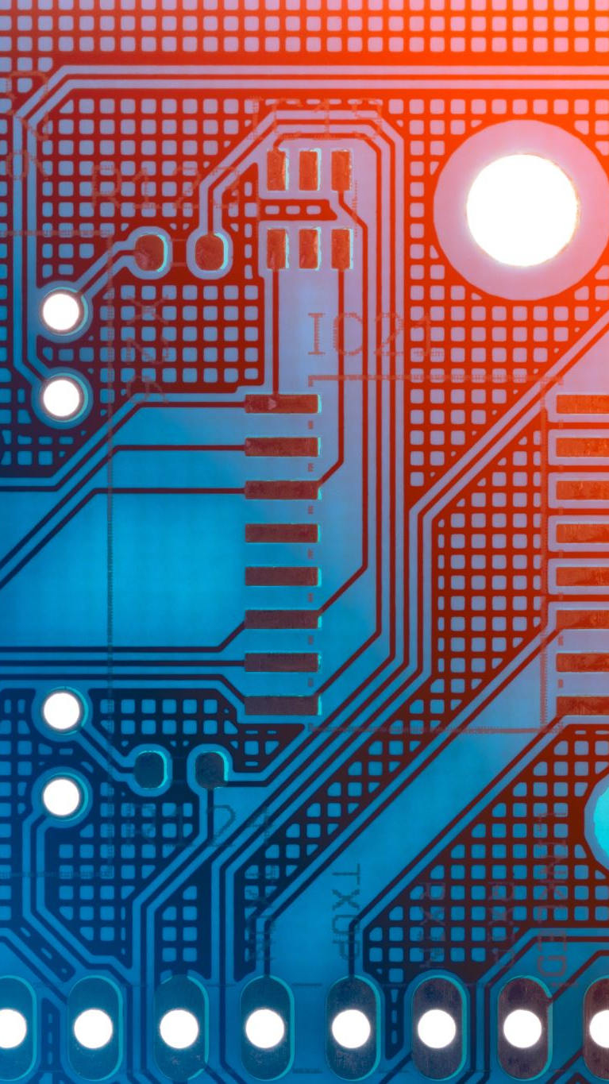
Working of Processor
A Microprocessor takes a bunch of instructions in machine language and executes them, telling the processor what it has to do. Microprocessor performs three basic things while executing the instruction:
It performs some basic operations like addition, subtraction, multiplication, division, and some logical operations using its Arithmetic and Logical Unit (ALU). New Microprocessors also perform operations on floating-point numbers also.
Data in microprocessors can move from one location to another.
It has a Program Counter (PC) register that stores the address of the next instruction based on the value of the PC, Microprocessor jumps from one location to another and takes decisions.

Slide 13
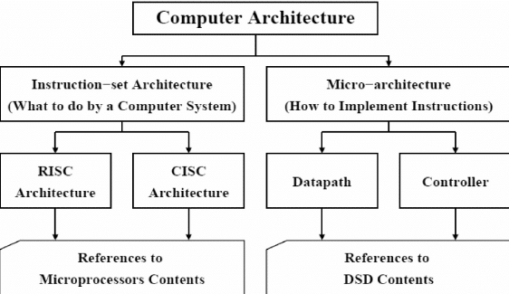
Computer Architecture
Computer architecture can be defined as a set of rules and methods that describe the functionality, management and implementation of computers.
To be precise, it is nothing but rules by which a system performs and operates.

Slide 14
Categories of Computer Architecture
System design – This includes all the hardware parts, such as CPU, data processors, multiprocessors, memory controllers, and direct memory access. This part is the actual computer system.
Instruction set architecture – This includes the CPU’s functions and capabilities, the CPU’s programming language, data formats, processor register types, and instructions used by computer programmers. This part is the software that makes it run, such as Windows or Photoshop or similar programs.
Microarchitecture – This defines the data processing and storage element or data paths and how they should be implemented into the instruction set architecture. These might include DVD storage devices or similar devices.

Slide 15
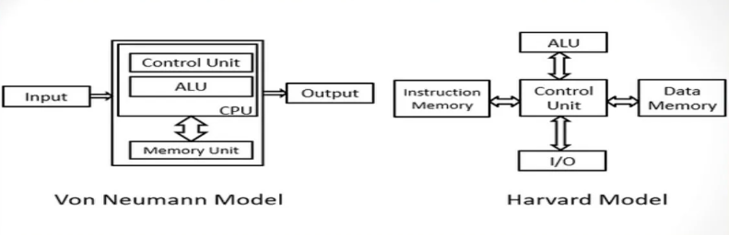
Difference Between Von-Neuman and Harvard Architecture
VON NEUMANN ARCHITECTURE | HARVARD ARCHITECTURE
It is ancient computer architecture based on stored program computer concept. | It is modern computer architecture based on Harvard Mark I relay based model.
Same physical memory address is used for instructions and data. | Separate physical memory address is used for instructions and data.
There is common bus for data and instruction transfer. | Separate buses are used for transferring data and instruction.
Two clock cycles are required to execute single instruction. | An instruction is executed in a single cycle.
CPU can not access instructions and read/write at the same time. | CPU can access instructions and read/write at the same time.
It is used in personal computers and small computers. | It is used in micro controllers and signal processing.

Slide 16

Thank You

